Slide 1
Photo TK
Minrui Huang, Brian Lee, Xietong Wei, Brett Heithold

Slide 2
What our project is focusing on
This app is an All-In-One tool kit that has many features.
Our user base are mainly the people that are interested in photography but feeling hassled about doing all the research and getting a hang of every situations, or simply people that just need its conveniency.

Slide 3
What we accomplished last sprint (Sprint 2)
A better looking UI
Weather feature
User register/login feature
User sign in/ out feature
Camera gears management feature
Add / update / delete gears in DB
Local celestial event searching feature

Slide 4
Accomplishment for this sprint (Sprint 3)
Weather- search by city
Calculator - calculate the exposure value
User account - change password, delete account
Geolocation can be saved into database
Dark Theme UI
Advertising video for our app
About us page

Slide 5
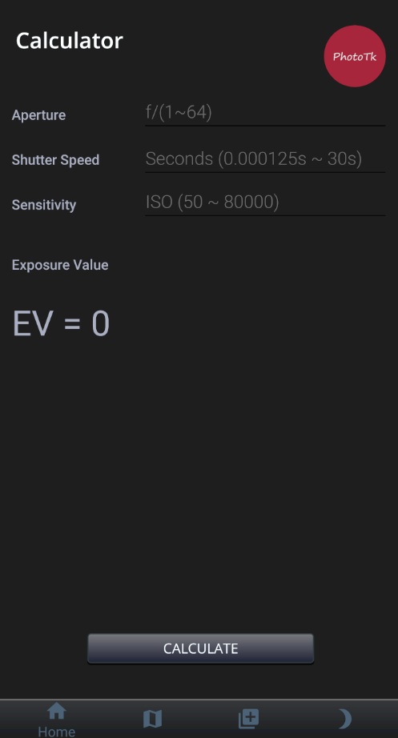
Calculator
Exposure is the amount of light that reaches your sensor, so it is important to know the exposure value.
This calculator use the aperture, shutter speed and ISO to calculate out the exposure value for people to adjust their camera gears.

Slide 6
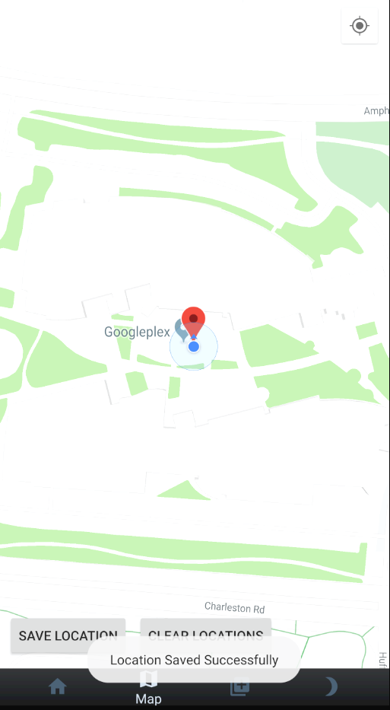
Save and clear location
Users can now add markers to the map
This can be helpful when trying to remember where certain photographs were taken
Markers can also be cleared

Slide 7
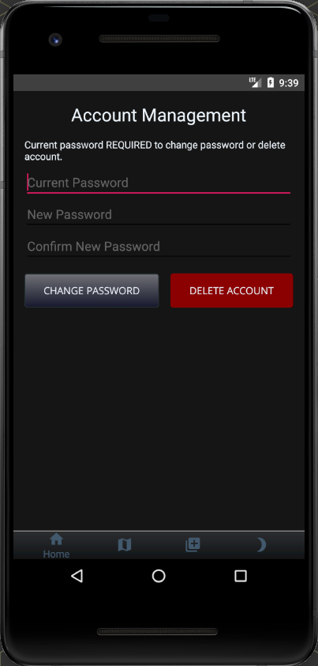
Account Management
Change password
Delete account
User is required to type in their current password to delete account or update password
TODO: make password strength requirements more stringent (only requires >= 8 right now)

Slide 8
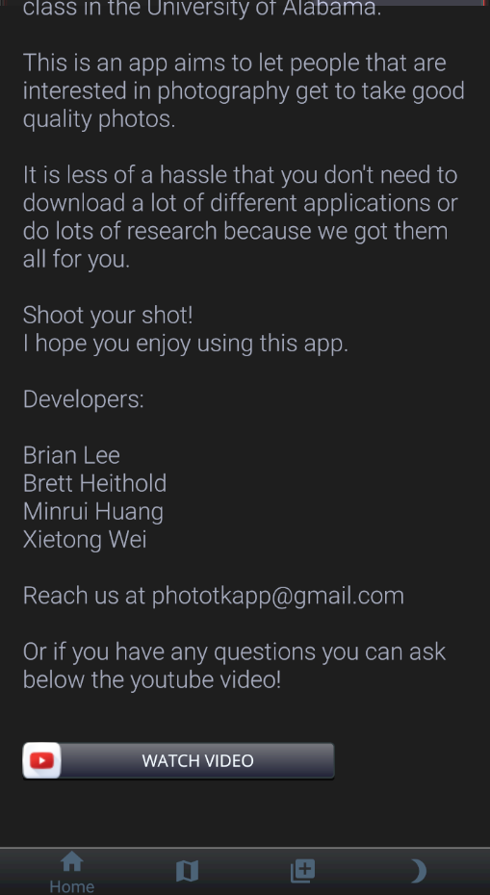
About Us
The about us page list the info of the team member and the brief description of the app, with the contacts for users to ask questions and a link to our youtube video.

Slide 9
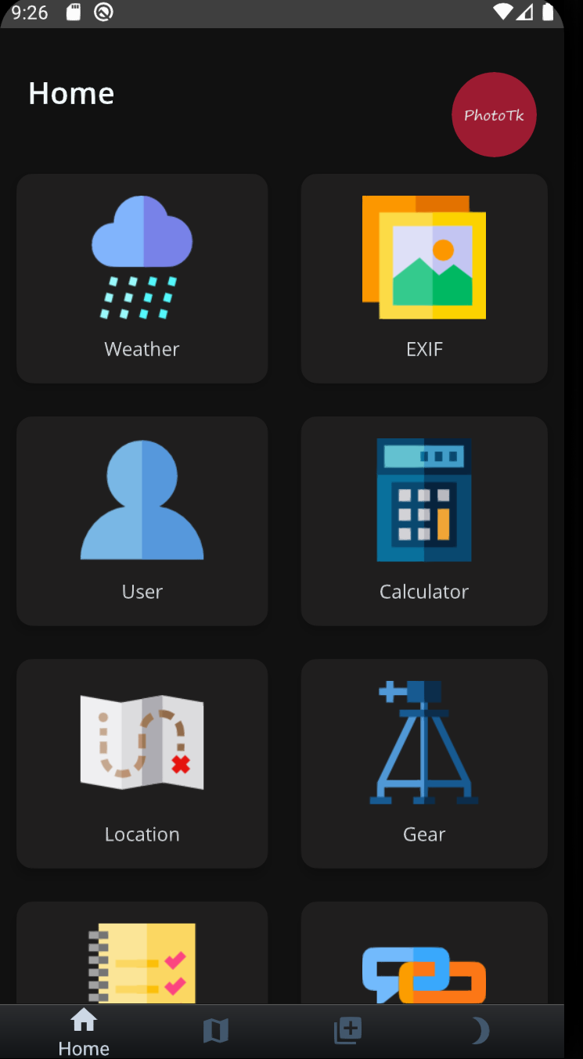
UI
We make some changes on the UI design including colors, fonts, backgrounds, buttons and icons with the same layout like last time.
We implement dark theme to the UI design for ease of use in dark.

Slide 10
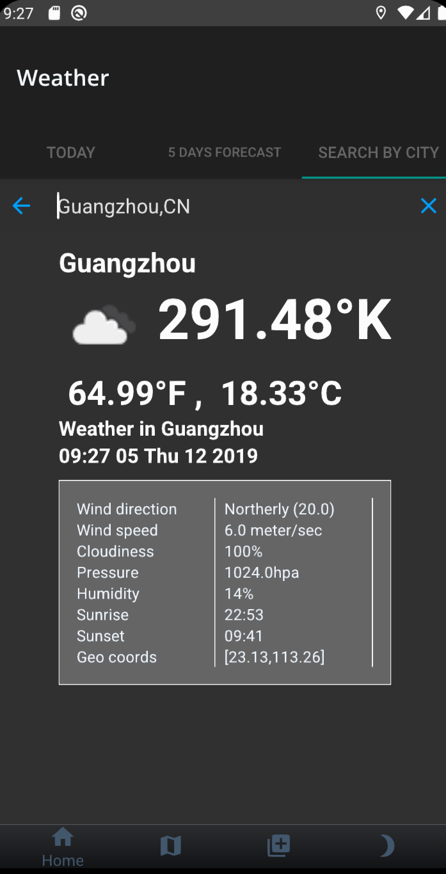
Search By City Name
Users are now able to type in the city names to find the weather for that city today.
It is helpful to let users know the situation they are going to handle.

Slide 11
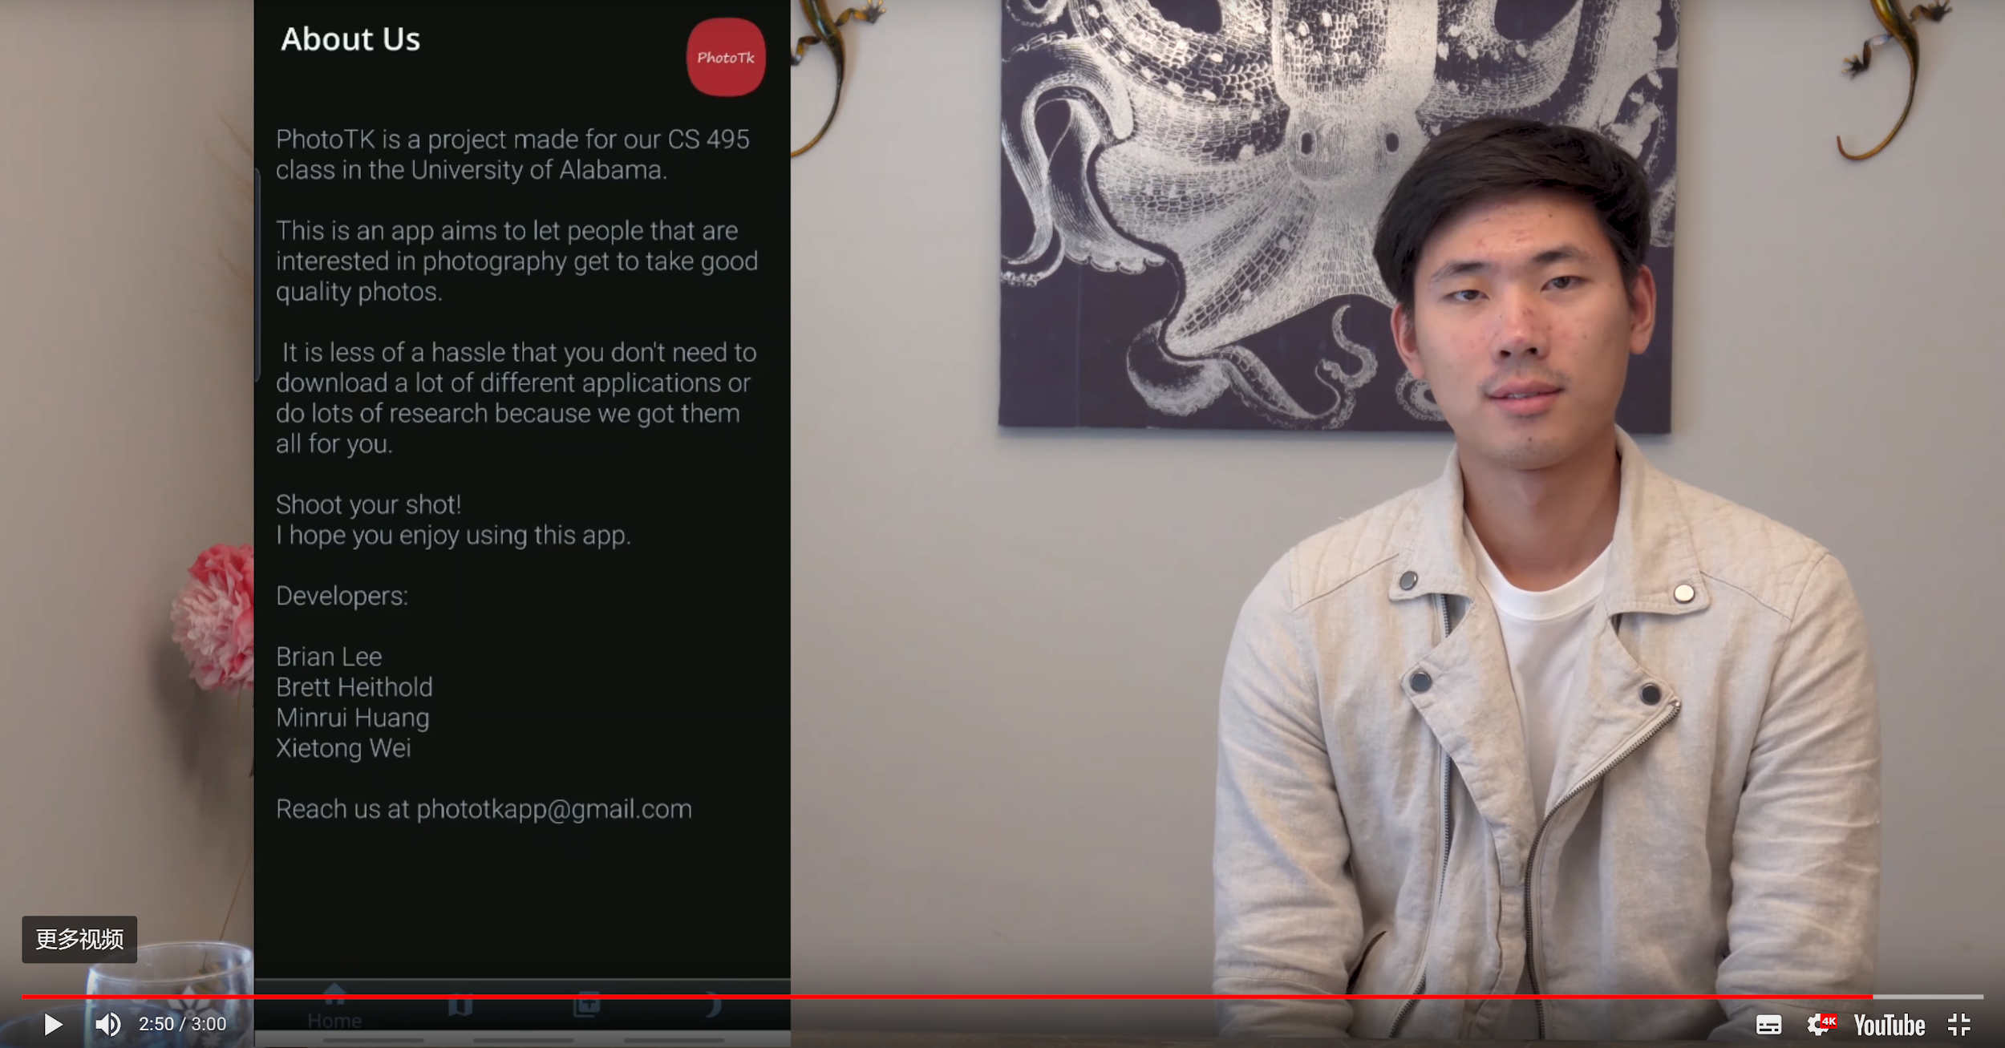
Video
We create a video that advertises our app.
IT IS IN 4K.
We use Adobe pr to edit this footage

Slide 12
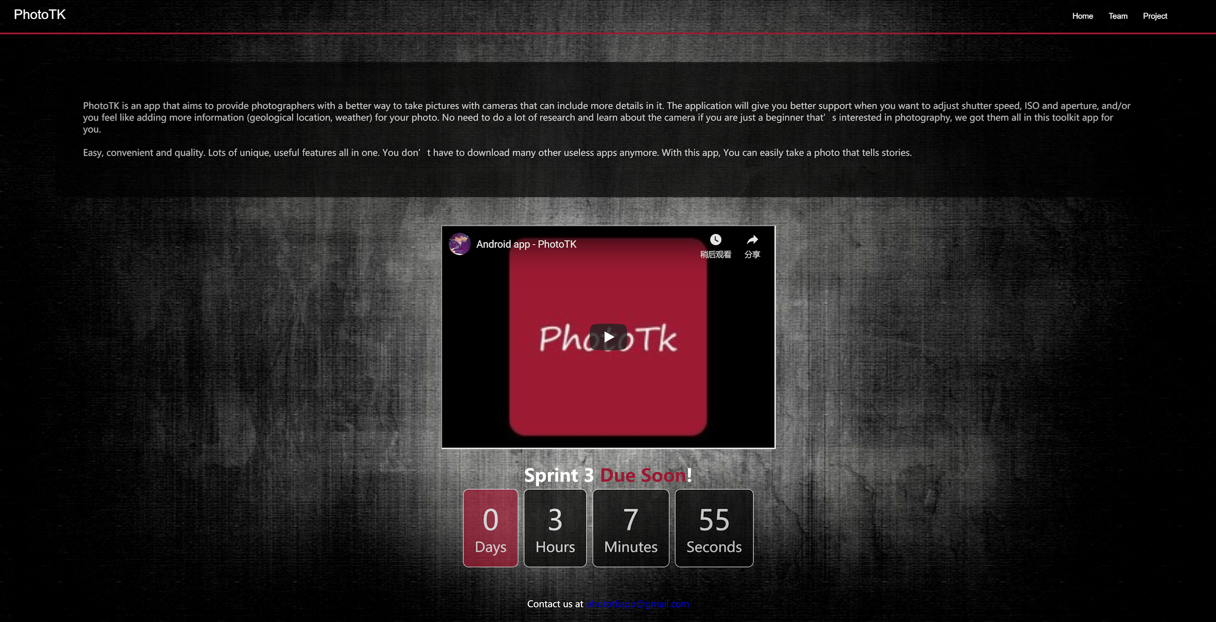
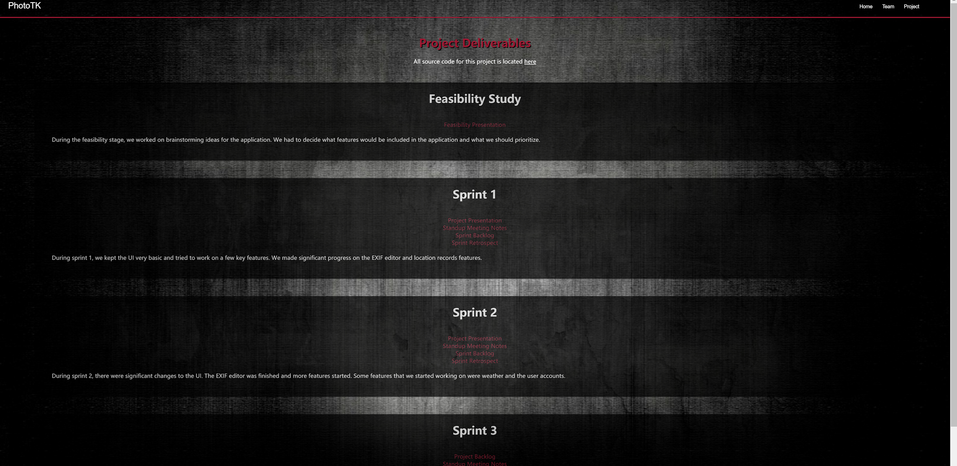
Website
Our website has a home page, team member page, deliverables page and about page. In the deliverables page the documents of every sprint can be downloaded. And our application video is on the first page. The top right is home page, and the bottom right is the deliverable page.

Slide 13
Challenges
Changing the layout of UI to fix the suitable screen size.
Making the application a perfect UI design.
Creating a good video to introduce our application.
Searching Weathers by city

Slide 14
Test Cases:
Test case 1:
Open the calculator and filling out the corresponding values for aperture, shutter speed and ISO, click the calculate button to see if the value match.
Test case 2:
Test for invalid user registration (invalid email and/or password)
Test case 3:
Open the about us page, and scroll down to find the button that’s linked to our video to click.

Slide 15
Demo
Any Question?

